Slide 1
DSC3013 Intro. to Social Media Analytics (Lec. 2)
Hao PENG
Department of Data Science
City University of Hong Kong
https://haoopeng.github.io/

Slide 2
Agenda
What is social media analytics?
Data foundations: types, features, collection, quality, ethics
Theoretical foundations: SM-related social science theories
Integrating theory and data
In-class activity and summary
Find your home group on Canvas
Two group paper presentation each week

Slide 3
Learning Objectives
By the end of this lecture, you will be able to:
• Define social media analytics and its core components
• Identify major types of social media data and its collection
• Explain key data quality, access, and ethics challenges
• Understand and apply core theories to social media data
• Match these theories to measurable SM metrics & behaviors

Slide 4
What Is Social Media Analytics?
Definition:
The systematic collection, processing, analysis, and interpretation of social media data to understand communication, behavior, networks, and social phenomena.
Examples:
• Brand public opinion
• User segmentation / profiling
• Influencer identification
• Election trend tracking
• Misinformation detection
• Cascade / popularity prediction

Slide 5
Levels of Analysis
Level
Focus
Example
Micro
Individual user, post
Why do people share health news?
Meso
Community, organization
How do activist groups coordinate?
Macro
Platform, society
How do platforms shape political talk?

Slide 6
Why Data and Theory Together?
• Data without theory = noise, meaningless patterns
• Theory without data = untested speculations
Strong social media analytics asks:
What question am I answering?
Which theory might explain the phenomenon?
What data can help test or explore that theory?
Notes:
Too descriptive, lack of depth;
Too abstractive, lack of details;

Slide 7
From Social Action to Dataset
Pipeline:
User behavior → Platform trace → API / scrape → Raw dataset → Cleaning → Analysis → Interpretation
• A (re)tweet, like, share, or view becomes a data point
Each action is shaped by platform design and social context.
Notes:
On X, LinkedIn and TikTok, you can check out everyone’s profile for public accounts.
On WeChat and Facebook, interactions and actions are more reciprocal / mutual, limited to close friends.

Slide 8
Major Types of Social Media Data
1. Content data
text, images, video
2. User profile data
bio, location, follower counts
3. Network data
follows, retweets, mentions
4. Behavioral data
likes, shares, clicks, view time
5. Temporal data
timestamps, posting frequency
6. Spatial data
geotags, check-ins

Slide 9
Structured vs. Unstructured Data
Structured
Unstructured
User IDs, avatar, timestamps, metrics, locations, etc. Easy to store in data tables
Text, images, video, audio Requires NLP, computer vision, and data cleaning
Analytics challenge:
Converting unstructured data into analyzable form
* Text preprocessing
* NLP pipelines
Notes:
What else?
Examples?

Slide 10
Metadata — Data About Data
Metadata includes:
• URLs
• Language
• Device type
• Hashtags / Geotag
• Retweet / reply status
• Verified / unverified status
Why it matters: Metadata gives context and enables filtering.
How can we compare interface popularity of a platform?
(web vs. mobile; android vs. ios)
Notes:
E.g., comparing the platform usage popularity (web vs. app) by social media users.

Slide 11
Text Data
Text appears in:
• Posts, tweets, captions
• Comments and replies
• Bios and user_names
• Hashtags and mentions
Common techniques:
• Tokenization • Normalization, cleaning
• Topic modeling • Named entity recognition
Notes:
Which platforms are rich in Text data?

Slide 12
Image and Video Data
• Instagram photos, TikTok videos, YouTube content
• Memes, infographics, screenshots
Requires:
• Computer vision
• OCR for text in images
• Audio/video transcription
Why it matters: Visual content often drives higher engagement.
What vocal / body features improve views of Ted Talks?

Slide 13
Behavioral Data
Includes:
• Likes
• Shares / retweets
• Comments / mentions
• Reactions (deleting)
• Click-throughs (CTR)
• Time spent viewing
Caveat: behavior ≠ attitude. A like or comment may be ironic, habitual, or even accidental.
• “Retweet does not imply endorsement”.

Slide 14
Social Graph / Network Data
• Nodes: users, pages, groups, hashtags
• Edges: follows, retweets, replies, mentions, shares
(Un) Directed: A follows B, but B may not follow A
(Un) Weighted: number of interactions
Use case: Identify influencers, communities, information flow
Notes:
Give examples for Directed vs. Undirected?

Slide 15

Temporal and Spatial Data
Temporal Data
Spatial Data
• Timestamps • Posting times • Event sequences Detect trends, bursts, life cycles (virality) of content
• Geotags • Check-ins • Language location Map events, local crises, regional differences
Notes:
We investigate the extent to which social ties between people can be inferred from co-occurrence in time and space?
Such issues arise in data originating in both online and off-line domains as well as settings that capture interfaces between online and offline behavior.

Slide 16
The 5 Vs of Big Social Data
V
Meaning
Social media example
Volume
Scale
Millions of posts per day
Velocity
Speed
Real-time livestreams, trends
Variety
Formats
Text, image, video, audio
Veracity
Quality
Bots, spam, misinformation
Value
Usefulness
Insights for decisions

Slide 17
Big SM Data — Scale and Limits
• Enormous scale enables systematic pattern discovery
But “big” does not mean:
• Complete
• Objective
• Representative
• Platform APIs often limit full access
• Spam and bot accounts
• Missing or incomplete data
Impact: Poor quality data lead to weak/wrong conclusions.
Key question: What is missing from the dataset?
Notes:
What else? Only certain subpopulation is well represented in a platform. E.g., More women on RedNote. Where are the men represented? (hubs?)

Slide 18
Missing Data and Bias
Who is absent from social media data?
• Older adults (or Teenagers)
• Low-income (status) users
• Non-users (agents, zombie)
Other sources of bias:
• Algorithmic filtering shapes what you see
• Self-selection bias: only certain people post
• Platform demographics differ and evolve

Slide 19
Sampling Social Media Data
Random sample
hard to obtain via APIs
Keyword /
hashtag sample
biased by topic interest
Snowball sample
follows network links
Snapshot / Census
collect all available posts for a narrow event
Always report sampling strategy and acknowledge limitations.
Notes:
Use streaming API
Identify similar hashtags (BLM, blm, cybercab, cybercrab, etc.)
Snowball bias towards famous accounts
Snapshot not always available.

Slide 20
Data Preprocessing Basics
Before analysis:
• Remove duplicates
• Filter bots and spam, invalid data
• Detect/filter language (e.g., focus on English)
• Normalize text (lowercasing, remove emoji?)
• Handle missing values (Drop? What percentage?)
• Convert formats (e.g., year to categorical data)
Remember GIGO: Garbage In, Garbage Out

Slide 21
How to Collect SM Data?
Download data from public repositories ☺
API is also easy (official & third-party APIs)
Tweet official API vs. TweePy
Build customized web crawler (parse data in html)
Python packages: Requests, BeautifulSoup, etc.
More details in DSC2005 course
Browser-like crawler (e.g., Selenium, LLM agent)
To deal with dynamic pages (JavaScript)
Notes:
What’s dynamic page? E.g., your Instagram web page.

Slide 22
Secondary Data Repositories
Using existing datasets can save time:
• Academic datasets (from published papers)
https://www.nature.com/articles/s41597-021-00934-7
https://www.nature.com/articles/s41467-025-60590-y
• SNAP network data
https://snap.stanford.edu/data/
• Kaggle social media datasets:
https://www.kaggle.com/datasets?search=Social+Media
Advantages
Limitations
Faster, often cleaned
May not fit your research question, lack documentation

Slide 23
APIs for Data Collection
• API = Application Programming Interface
Many platforms provide (free) structured access
Types:
• REST API: search endpoints (users, posts, tags, etc.)
• Streaming API: real-time sample (often a small fraction)
Examples:
X API (Twitter), Reddit API, Meta Graph API, YouTube Data API

Slide 24
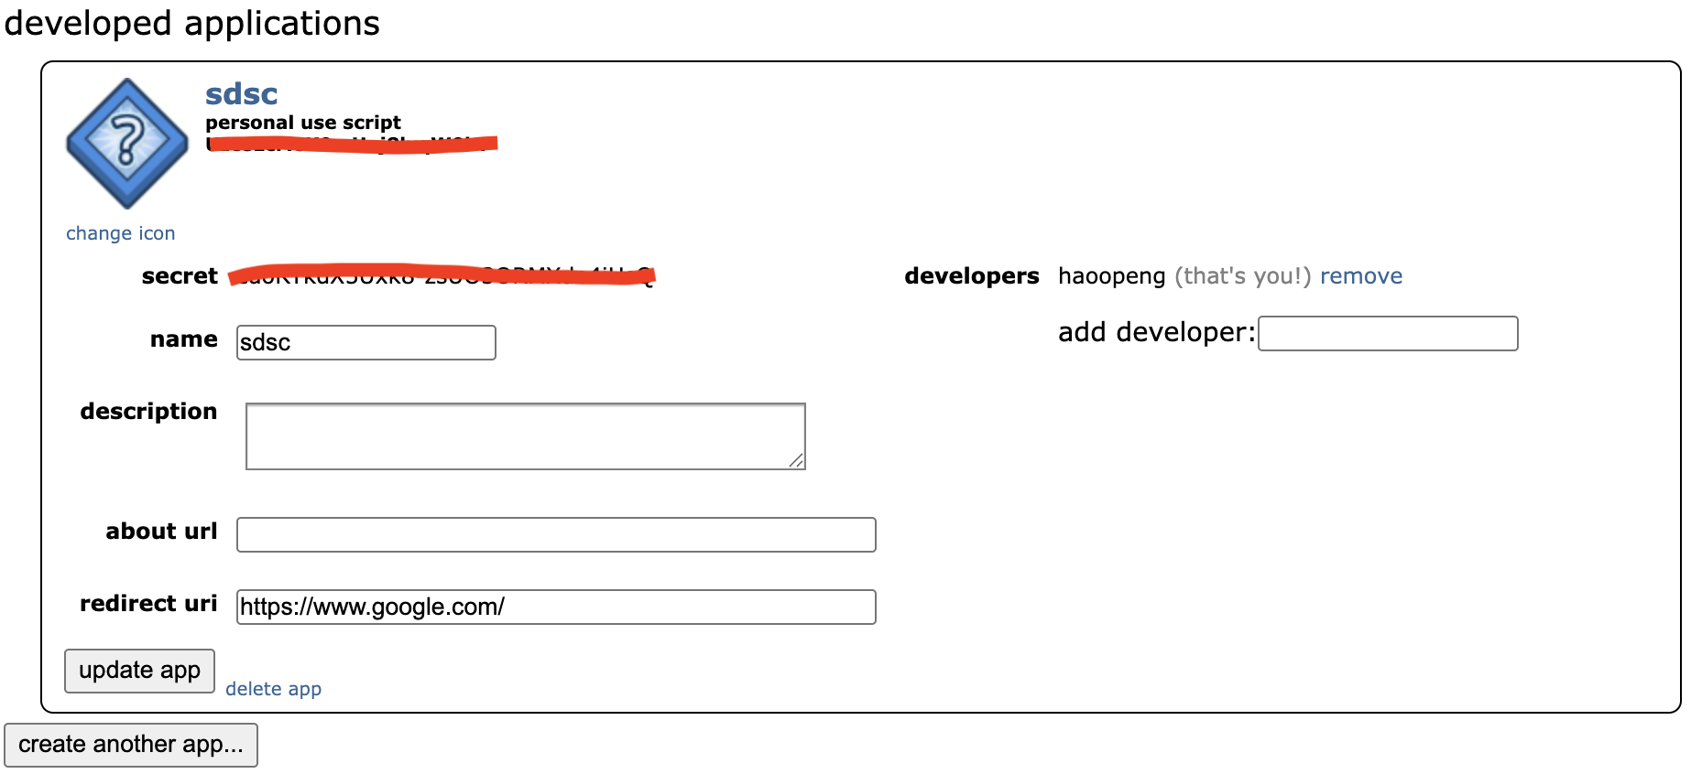
Collecting Reddit Posts
Step 1: Create an APP and get API access token first
https://www.reddit.com/prefs/apps

Slide 25
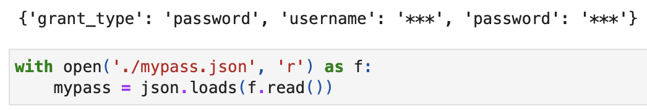
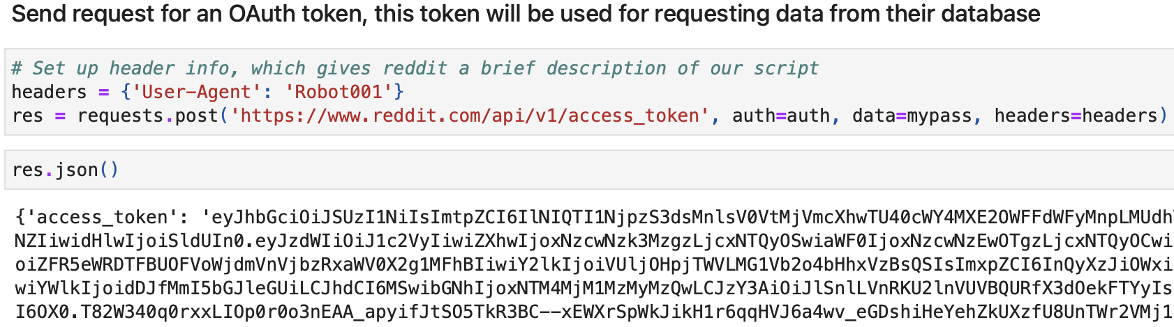
Collecting Reddit Posts
Step 2: Request a temporary OAuth token
auth = requests.auth.HTTPBasicAuth(CLIENT_ID, SECRET_KEY)
Notes:
Construct an auth instance

Slide 26
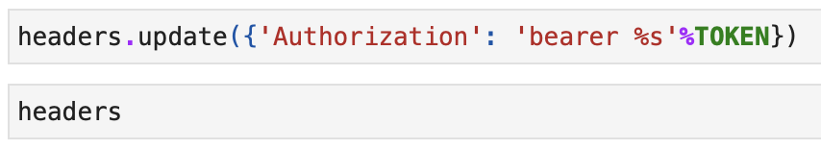
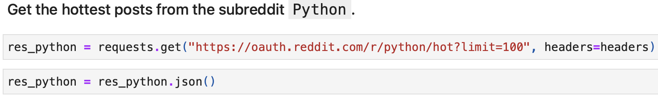
Collecting Reddit Posts
Step 3: Update header with authorized token
Step 4: Read to query data from their server!
API endpoints: https://www.reddit.com/dev/api/#section_account
Be mindful of rate limit.

Slide 27
Web Scraping
• Scrape/extract data from web pages
May violate platform Terms of Service
Legal status varies by country and context
Ethical principles:
• Respect user privacy
• Collect only what you need
• Do not bypass access controls
Key point: Public data ≠ ethical to use in all research.

Slide 28
Data Privacy and Ethics
Key principles:
• Anonymization of personally identifiable data
• Obtain informed consent when possible
• Transparency about data use in reports
• Compliance with institutional IRB rules
Q to always ask: Who could be harmed by this research?

Slide 29
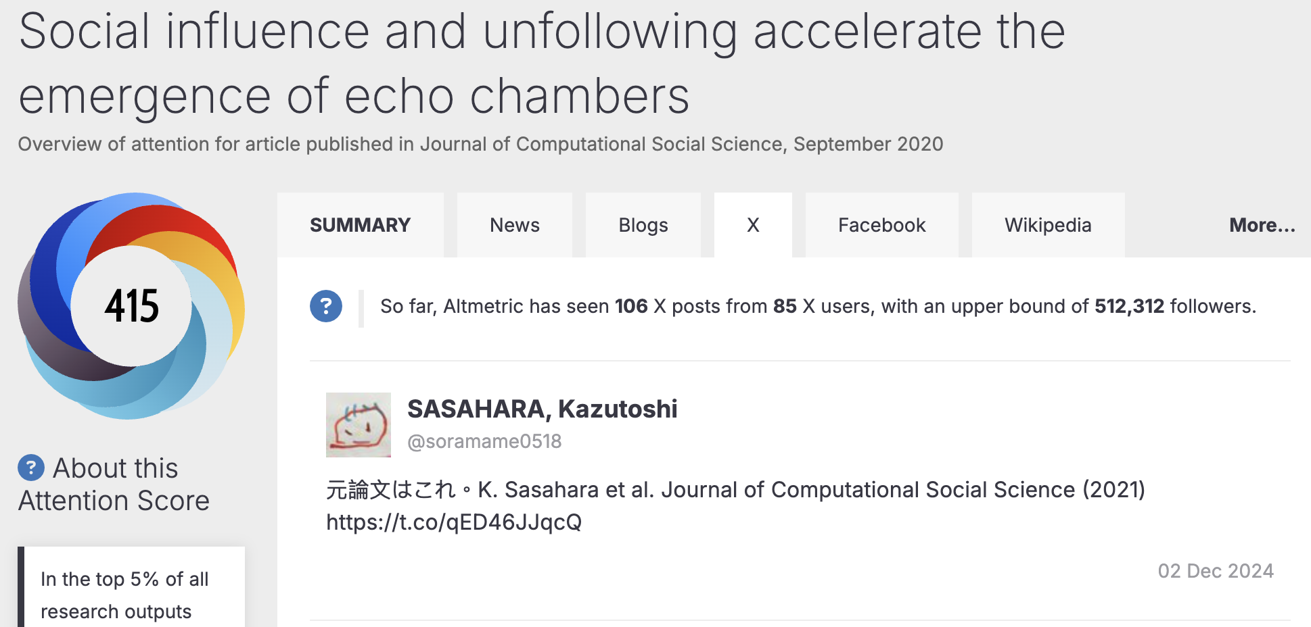
Exercise time
Can Altmetric display Tweet content of each paper?
Can Altmetric share the Tweet content of each paper?
https://link.altmetric.com/details/60364782/twitter

Slide 30
Why Theory Matters in Analytics
Theory helps you:
• Formulate research questions
• Operationalize relevant variables
• Interpret relationships / correlations
• Generalize beyond a single dataset / context
• Situate your findings with existing literature
Analogy: Theory is the map; data is the terrain.

Slide 31
Overview of SM-related Theories
Social Identity Theory
Group membership & intergroup behavior
Homophily
Similarity breeds connection
Confirmation Bias
Seeking information that confirms beliefs
Social Reinforcement
Feedback loops strengthen behavior
Collective Action
Coordinated action toward shared goals
Structural Holes
Brokerage between disconnected groups

Slide 32
Social Identity Theory
Definition: People derive part of their self-concept from membership in social groups. They favor in-groups and discriminate against out-groups, leading to polarized attitudes and behavior.
Key Concepts:
• Social categorization: "us" vs. "them"
• In-group favoritism: positive bias toward own group
• Out-group hostility: negative bias toward other groups
SMA Application:
• Analyzing political polarization and echo chambers
• Studying hashtag activism and online social movements
• Explaining hostile interactions between fan communities

Slide 33
Homophily
Definition: The tendency for individuals to connect and interact with others who are similar to them in attributes such as demographics, interests, or opinions. It can lead to homogeneous networks.
Key Concepts:
• Similarity on visible traits (race, gender, age)
• Similarity on invisible traits (values, attitudes, beliefs)
• Leads to echo chambers and filter bubbles
SMA Application:
• Measuring network homogeneity using user attributes
• Explaining why fake news stay within like-minded clusters
• Identifying communities around shared interests or identities

Slide 34
Confirmation Bias
Definition: The cognitive tendency to search for, interpret, favor, and recall information that confirms one's pre-existing beliefs, while giving much less attention to contradictory information.
Key Concepts:
• Selective exposure: pick content that aligns with existing views
• Biased interpretation: seeing ambiguous info. as supportive
• Memory bias: better recall of confirmatory evidence
SMA Application:
• Explaining echo chambers and filter bubbles
• Understanding resistance to fact-checking and corrections
• Fake news spread within ideologically homogeneous networks

Slide 35
Social Reinforcement
Definition: The process by which user behaviors, attitudes, or beliefs are strengthened through positive social feedback (likes, shares) or through repeated exposure within one's network.
Key Concepts:
• Operant conditioning: rewards increase behavior frequency
• Social validation: others' approval legitimizes one's views
• Feedback loop: engagement encourages similar content
SMA Application:
• Analyzing why certain posting styles or topics persist / recur
• Modeling complex contagion as a reinforcement process
• Understanding diffusion pathways in online communities

Slide 36
Social Capital
Definition: The resources—information, support, trust—embedded in social networks that individuals can access through their relationships.
Key Concepts:
• Bonding capital: emotional support, close-knit groups
• Bridging capital: diverse information, weak ties
• Reciprocity and trust as foundations
SMA Application:
• Measuring the value of online communities for members
• Analyzing how social media builds or erodes social capital
• Comparing platforms:
Facebook may build bonding; LinkedIn builds bridging

Slide 37
Collective Action
Definition: Coordinated action by individuals to achieve a shared goal or express a collective identity. In digital contexts, collective actions emerge through personalized, loosely coordinated participation (e.g., hashtags, memes) without formal organizational structures.
Key Concepts:
• Shared identity or goals
• Mobilization through hashtags and viral content
• Mass action: low-barrier, individualized participation
SMA Application:
• Studying OSM like #MeToo, #BlackLivesMatter, climate strikes
• Tracking participation dynamics via hashtag retweet networks
• Analyzing how online action translates to offline protest

Slide 38
Structural Holes
Definition: A structural hole is a gap between two clusters in a network. Individuals whose position bridge these holes—called brokers—can gain access to diverse information, control its flow, and act as intermediaries.
Key Concepts:
• Broker: occupy a position between otherwise isolated groups
• Information benefits: access to diverse resources
• Control benefits: ability to filter, distort, or withhold information
SMA Application:
• Identifying influencers who connect different communities
• Measuring a user's bridging capital in retweet networks

Slide 39
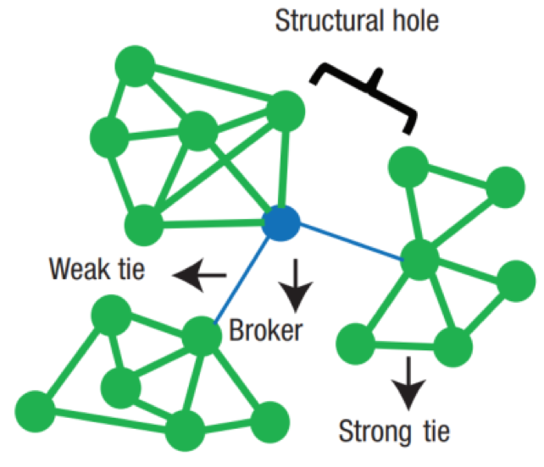
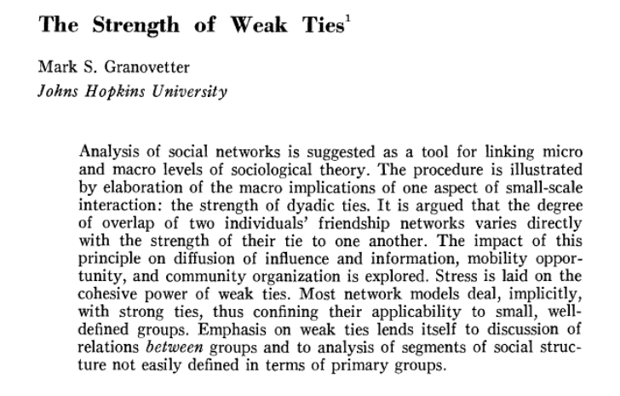
Strength of Weak Ties
The idea that people often land jobs via weak connections.
One of the most (missed) influential ideas in social science.
https://www.jstor.org/stable/2776392
https://www.youtube.com/watch?v=g3bBajcR5fE

Slide 40
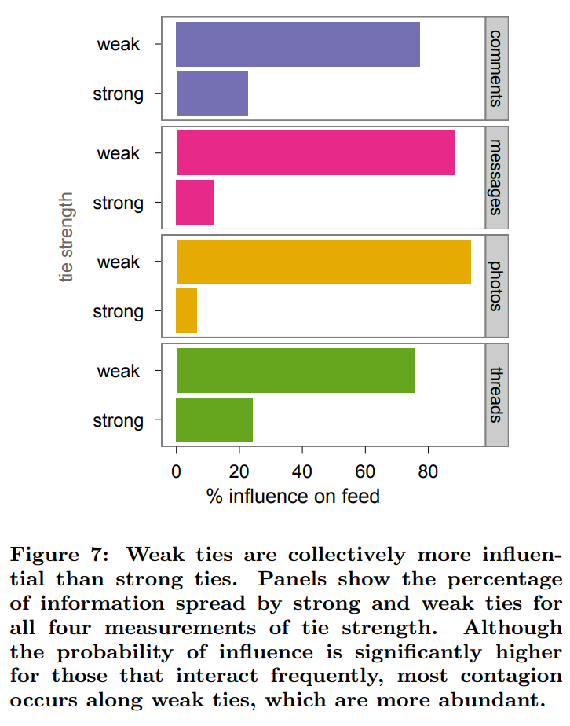
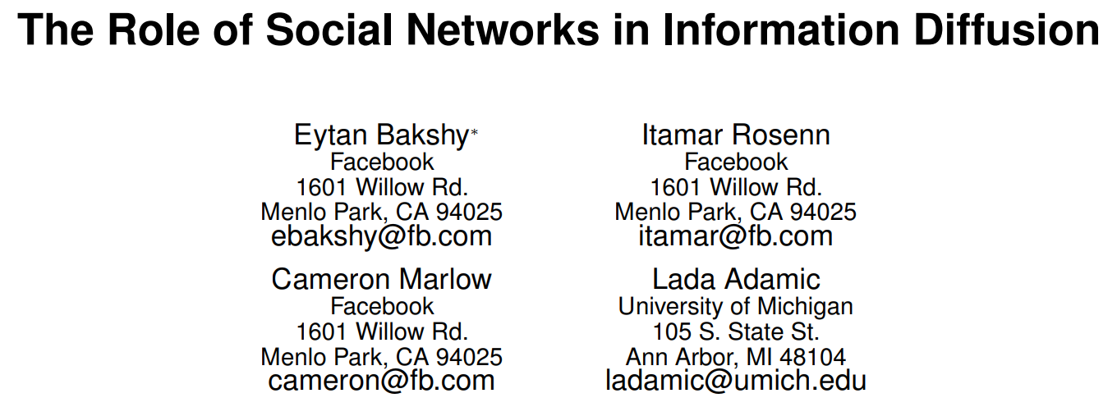
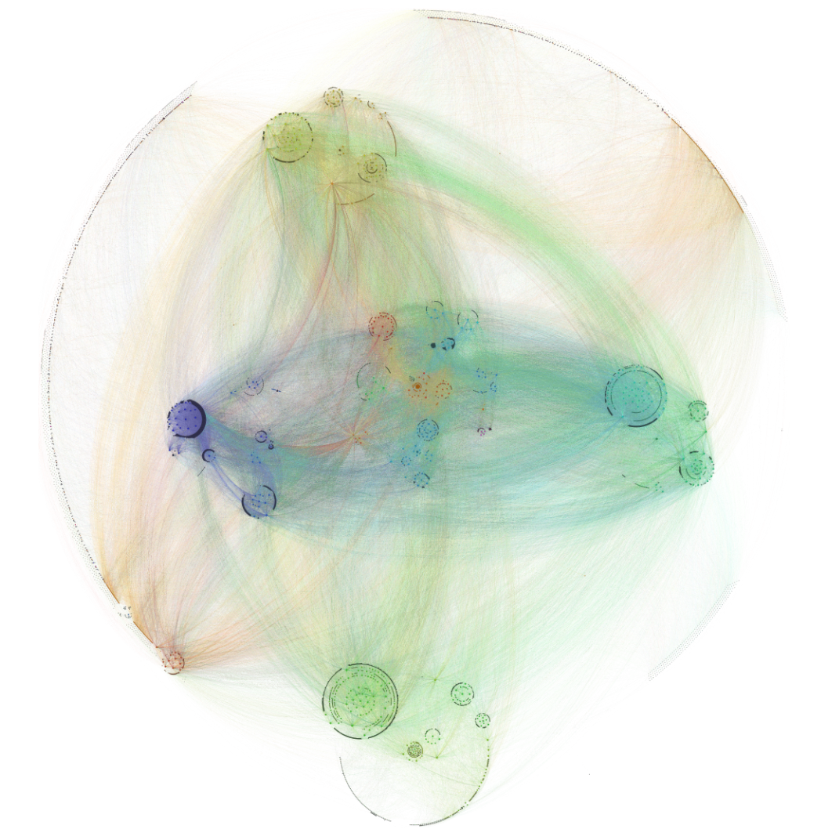
Evidence on Facebook

Slide 41
Integrating Theories with Data
Theory
Key Concepts
Measurable Social Data
Social Identity
Group identity, in-group bias
Hashtag communities, language markers
Homophily
Similarity, network homogeneity
User bios similarity, follower overlap
Confirmation Bias
Selective exposure, biased interpretation
Sharing patterns, engagement with fact-checks
Social Reinforcement
Feedback loops, reward
Likes, comments, posting frequency over time
Structural Holes
Brokerage, information control
Betweenness centrality, cross-community connections
Collective Action
Shared goals, mobilization
Hashtag growth, retweet cascades, OSM
Notes:
If you want to study the survival or success of online communities, how do you define them and what data do you collect?
If you want to understand the correlation between homophily and link formation, how do you define or operationalize and measure homophily?

Slide 42
Example — Applying Theories
Scenario: A health hashtag campaign goes viral on Twitter communities.
(#IceBucketChallenge, #A4waist, etc.)
Theories applied:
• Homophily: The hashtag spreads first within ideologically similar clusters.
• Confirmation Bias: Early adopters quickly share the information that fits their existing health beliefs / habits.
• Social Reinforcement: Reluctant users who are exposed to multiple such posts will further post similar content. Starting a chain reaction.
• Structural Holes: A few brokers share the same hashtag across different communities, expanding its reach.
• Collective Action: The hashtag eventually evolves into a coordinated push for cultural / lifestyle change, possibly via wide news coverage to the public.
Data used:
user bios, engagement timestamps, retweet network, hashtag co-occurrence
Notes:
hashtag co-occurrence to identify related posts with variants.

Slide 43
In-Class Activity
Small group task:
1. Pick a social media phenomenon:
• Viral TikTok video (#cybercab)
• Brand backlash on RedNote
• Political hashtag campaign
2. Choose two related theories from today's list
3. List three data types you would collect to study it
4. Identify one bias in that data
Be ready to share in 5 minutes.
Notes:
Xiaomi / Xpeng car

Slide 44
Key Takeaways
• Social media data are diverse, messy, and biased
• Data collection requires technical, legal, and ethical care
Several core theories provide lenses to turn data into insight:
• Social Identity Theory
• Homophily
• Confirmation Bias
• Social Reinforcement
• Collective Action
• Structural Holes
Strong analytics = theory + data + critical thinking
Always ask: What is missing? What does a metric really mean?

Slide 45
Discussion Questions
• Which theory explains why people join online social movements?
• How can social reinforcement be measured in diffusion data?
• What is the difference between structural holes and weak ties?
• How might confirmation bias help the spread of fake news?
• Which theories would you use to study brand loyalty on IG?
Notes:
Q2: calculate the likelihood of sharing as a function of num of exposure. Build a network based on mentions, retweets, or followers.

Slide 46
Course note
Find your home group on Canvas
You may be randomly assigned to a team.
Talk to your teammates as early as you can.
In future weeks, please inform your choice of paper to the whole class on Canvas (Discussion Page) one week before.
* First come, first select (of “dream” paper)

